Slide 1
GES 317/417: Urban Theory
Prof. Scott Hegerty
Summer 2025
NEIU

Slide 2
Urban Theory
Some key concepts:
Why do cities exist?
Internal Structure of the City
Networks of Cities

Slide 3
Why do cities exist?
Economic approach: Choose lower cost (given basic assumptions)
Production + transportation
Cheaper at a factory vs. at home
But cost increases with distance from factory
Eventually city’s advantage ends
Costs
Distance

Slide 4
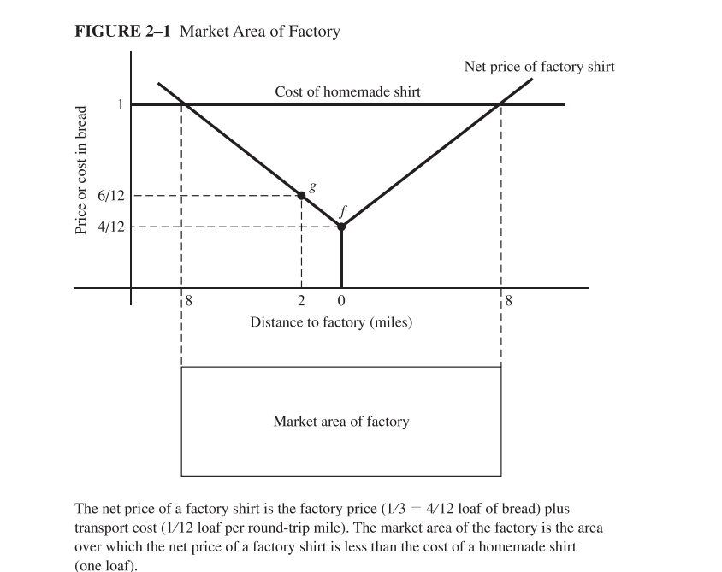
Why do cities exist?
Transportation costs
Cost (factory made) = Production plus transport → Eventually not cheaper than homemade → City radius

Slide 5
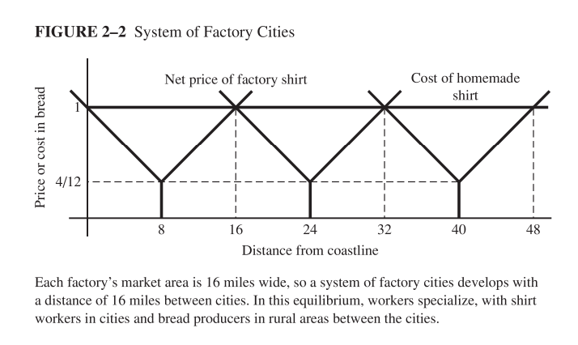
Why do cities exist?
Networks of cities based on radii

Slide 6
Why do cities exist?
Network effects within cities Value increases with number of users
Agglomeration economies Knowledge spillovers Increased productivity
Information flows In-person, chance encounters—even today!

Slide 7
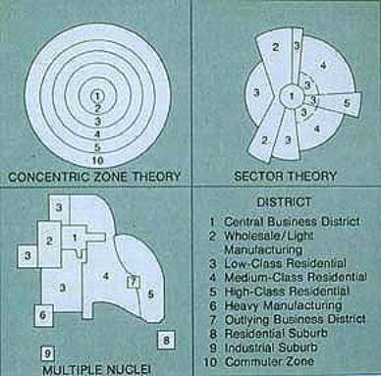
Internal Structure of the City
Various Theories:
Burgess (1925) Concentric zones
Hoyt (1939) Sectors
Harris & Ullman (1959) Multiple nuclei
Vance (1964) Urban realms
“L.A. School” (1980s) Game board

Slide 8
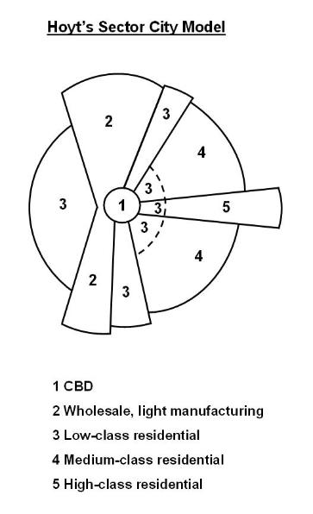
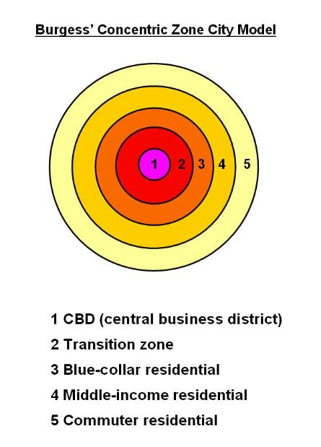
Internal Structure

Slide 9
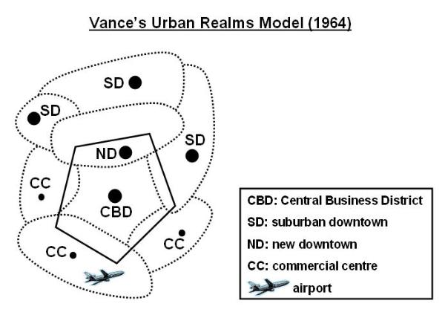
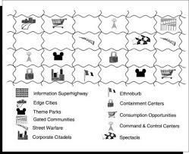
Urban Realms Los Angeles School

Slide 10
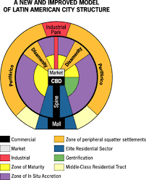
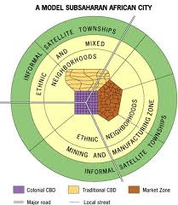
Applications worldwide
Africa: (de Blij)
Latin America: (Ford, 1996)

Slide 11
Defining Cities
Chicago vs. “Chicagoland”
Perception vs. functional vs. density vs. statistical vs. political
MSA, CBSA, defined
(from O’Sullivan, Urban Economics) →

Slide 12
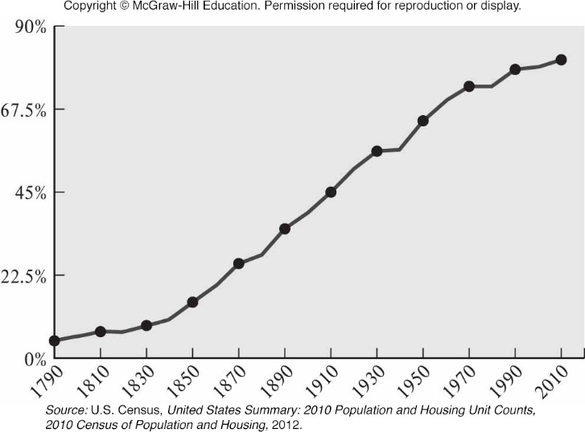
Trends in Urban Population: Percent of U.S. Population in Urban Areas, 1790–2010
Notes:
Presenter Note: This figure shows the percentage of people living in urban areas in the United States from 1790 to 2010. Over this period, the percentage of the population living in urban areas increased from 5 percent to 81 percent, a remarkable transformation that also occurred in other parts of the world. Urbanization was stagnant later in the 1970s, a decade that included a deep recession in 1973–1975.

Slide 13
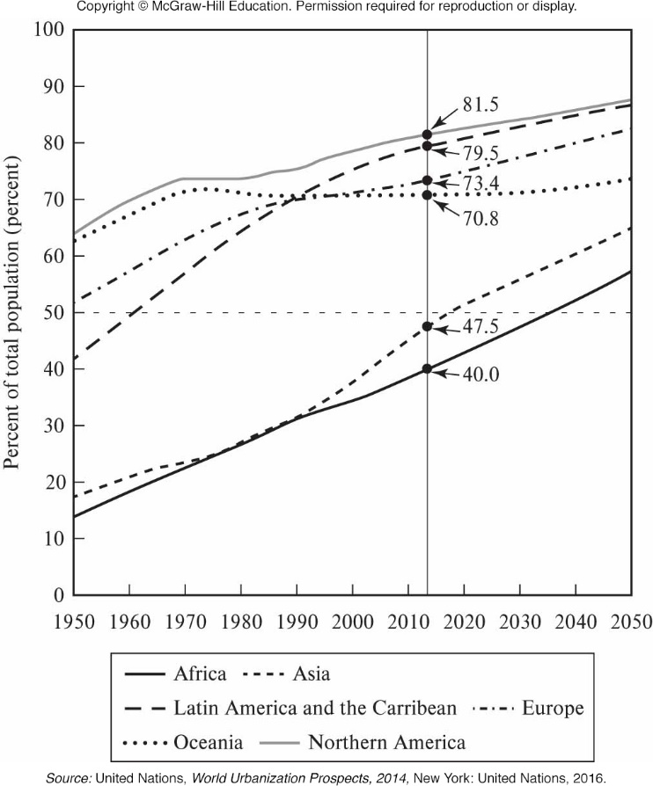
Trends in Urban Population: Urban Population as Percentage of Population, 1950–2050
Notes:
Presenter Note: This figure shows the time trends in urbanization as a percentage of population for six major areas in the world. The historical data goes back to 1950 and the projections go to 2050. The proportions are currently less than half in Africa (40 percent) and Asia (47.5 percent), but that is expected to change by 2035 in Africa and 2018 in Asia. In the other areas, the urban percentage ranges from 70.8 percent in Oceania to 81.5 percent in Northern America.

Slide 14
Geography 1: Urban Area
Geographical definitions of urban populations are based on a census block—the smallest geographical unit in census data.
A block is an area bounded by visible and invisible features. It has a few dozen to a few hundred residents.
A block group is a group of contiguous census blocks.
A tract is a contiguous set of census block groups with a target population range of 4,000 residents.

Slide 15
Geography 1: Urban Area (cont.)
The U.S. Census Bureau uses tracts to define two types of urban areas: urbanized areas and urban clusters.
Urbanized Area
densely settled core area of tracts and surrounding tracts that meet minimum density requirements
density of 1,000 per square mile (psm) for core and 500 psm for surrounding area
minimum population of 50,000.
Urban Clusters
scaled-down version of urbanized area with total population between 2,500 and 50,000

Slide 16
Geography 2: Metropolitan Area Core-Based Statistical Area
Each Core-Based Statistical Area (CBSA) contains at least one urban area with at least 10,000 residents.
Metropolitan areas include at least one urbanized area with at least 50,000 people.
Micropolitan areas include at least one urban cluster of 10,000 to 50,000 people.

Slide 17
Geography 2: Metropolitan Area (Core-Based Statistical Area) (cont.)
The building blocks for metropolitan and micropolitan areas are counties.
Central Counties
places where at least 5,000 people reside, or where half the population resides within an urban area with at least 10,000 people.
Additional Outlying Counties
included in the CBSA if at least 25% of residents work in central counties or if at least 25% of jobs in the county are filled by residents of central counties.

Slide 18
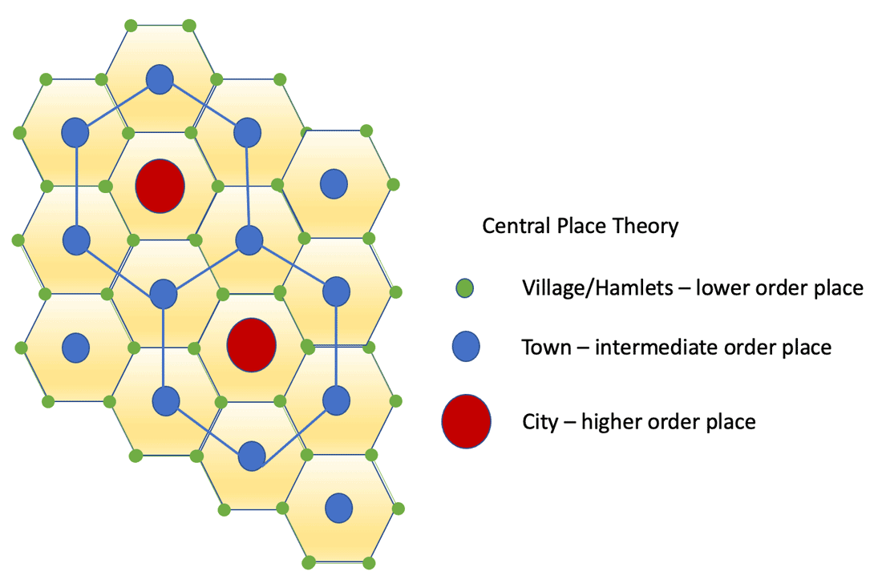
Systems of cities
Central place theory (Christaller, 1933) Specialized services, etc Market areas as hexagons

Slide 19
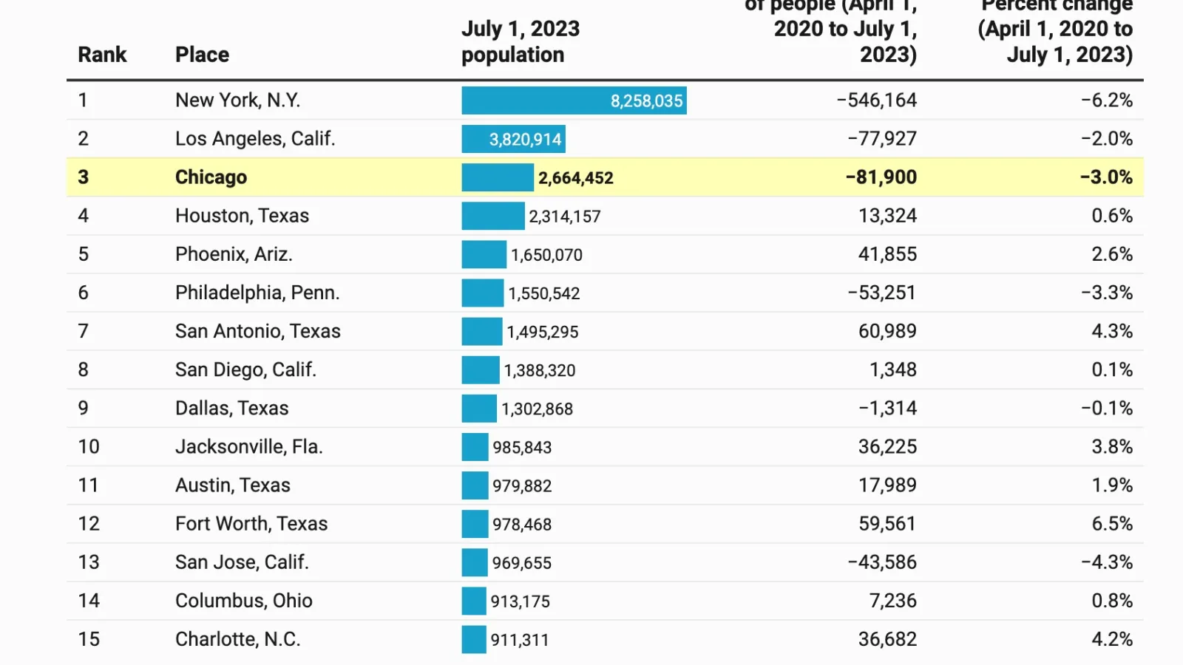
Systems of cities
Zipf’s Law (The “Rank-Size Rule”) (Chicago Tribune)
2nd largest city half as large as the largest
3rd largest city 1/3 the size, etc.
ln(Rank ) = a – b*ln(Size)
Coincidence, or forces at work?

Slide 20
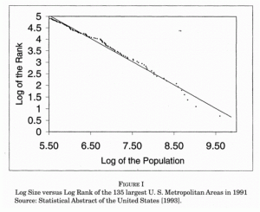
Systems of cities

Slide 21
In-class exercise: Zipf’s Law
Download Census Place Data: Population
Rank data, take logs
Scatterplot, regression?

